Slide 1
Lecture 5 – Using Functions
M30299 Programming
School of Computing University of Portsmouth

Slide 2
The idea of functions
We have already been using function definitions to allow us to write and test many small “programs” within a single file.
Most real-world programs are much longer than those we have written so far.
Typically, a program is a collection of several function definitions.
The purpose of using functions is:
to help break a large problem into smaller parts;
to improve the readability of code; and
to avoid repetition—writing similar code over and over again.
We will touch on each of these issues first, then see a slightly larger example at the end of the lecture; we’ll cover more realistic case studies later in the module.

Slide 3
A program as a collection of functions
def say_hello(): print("hello")
def say_goodbye():
print("goodbye")
def main():
say_hello()
say_goodbye()
main()

Slide 4
A program as a collection of functions
This simple program just displays:
hello goodbye
on the screen.
It consists of three function definitions, followed by a function call.
The main function calls the other two functions (the name main is just a convention we’ll use for the function that serves as a program entry-point).
Executing our program will cause the main() function call at the bottom of the program to be executed, so the main function will be called.
Program execution finishes after this function call is completed.

Slide 5
Using functions to break down large problems
Clearly, to write a program to carry out such a simple task we don’t really need to use several functions.
However, let’s briefly consider a more complicated problem:
Write a program that reads data about employees (salary, overtime hours, etc.) from a file, and then displays how much each should be paid this month.
A first step in designing a solution to this problem might be to break the problem down into three simpler sub-problems:
read employees’ data;
calculate wages; and
display wages.

Slide 6
Using functions to break down large problems
Each could be solved using a function, and main would be:
def main(): ... readEmployees(...) ... calculateWages(...) ... displayWages(...)
It is possible that the sub-problems could be broken down further. E.g., to calculate the wages of an employee involves:
calculating basic pay;
calculating overtime pay; and
deducting tax.
The solution to these sub-problems might be functions themselves.

Slide 7
Functions with parameters
Imagine that we want to display greetings to several different people. We might write the following:
def main(): print("Hello, Vicky. How are you today?") print("Hello, Tom. How are you today?") print("Hello, Fred. How are you today?") print("Hello, Sam. How are you today?") print("Hello, Gemma. How are you today?")
This would work, but it contains a lot of repeated code: the only difference between the greetings is the person’s name.
We define a function that has the name as a parameter...

Slide 8
Functions with parameters
def greet(name): print("Hello " + name + ".", end=" ") print("How are you today?")
The parameter name is a special variable whose value is initialised when the function is invoked or called.
When we call this function we supply an argument (a value for the parameter):
>>> greet("Sam") Hello Sam. How are you today? >>> greet("Fred") Hello Fred. How are you today?

Slide 9
Functions with parameters
Our main function can now be replaced by:
def main(): greet("Vicky") greet("Tom") greet("Fred") greet("Sam") greet("Gemma")
Apart from the overall reduction in text, what other advantage(s) might this new code – greet & main – have?

Slide 10
Functions that return values
We have used built-in functions that return values to the caller:
>>> euros = float(input("Enter amount in euros: ")) >>> print(math.sqrt(2)) 1.4142135623730951
Functions float, input and math.sqrt all return values (print doesn’t).
Notice that the calls to these functions are expressions (they have values and often appear on the right-hand-side of assignments).
Let’s write our own function that returns values:
>>> def square(x): return x * x

Slide 11
Functions that return values
A return statement like this causes:
the function to exit (control is passed back to the caller), and:
the returned value is given as the function call’s value.
Let’s use our user-defined square function:
>>> print(square(2)) 4 >>> z = 3 >>> y = square(z) >>> print(y) 9

Slide 12
Functions that return multiple values
We note that functions can return more than one value; e.g:
>>> def sum_and_difference(n1, n2): return n1 + n2, n1 - n2
returns both the sum and the difference of two numbers.
Such functions are often used together with a simultaneous assignment:

Slide 13
Functions that return multiple values
We can thus take the two values returned by
>>> def sum_and_difference(n1, n2): return n1 + n2, n1 - n2
and assign them to two separate variables:
>>> s, d = sum_and_difference(10, 3) >>> s 13 >>> d 7

Slide 14
Functions cannot change argument values
Consider the following code
def turn_up_heat(temp): temp = temp + 10
def main(): temperature = 15 turn_up_heat(temperature) print(temperature)
Calling main will result in the output value 15.
This is because only the (local) parameter temp’s value is changed inside the turn_up_heat function; the value of temperature is not changed.

Slide 15
Functions cannot change argument values
To change temperature’s value, we can rewrite our code to use a function that returns a new value, and then assign this value to temperature in main.
def hotter_temp(temp): return temp + 10
def main(): temperature = 15 temperature = hotter_temp(temperature) print(temperature)
We see that:
the call turn_up_heat(temperature) is a statement; and
the call hotter_temp(temperature) is an expression.

Slide 16
Writing function definitions – an example
Suppose that the cost of a cheese pizza is made up of:
the cost of the dough base (which is 1p per square cm);
the cost of the cheese topping (which is 2.5p per square cm).
Let’s write program that asks the user for:
the radius of the pizza (i.e. the radius of the base); and
the width of the crust;
and displays the total cost of the pizza in pounds.
cheese
radius of pizza
width of crust
base (with just the crust visible)

Slide 17
Splitting the task into two functions
We’ll start by splitting the task into two separate functions:
main - this will ask the user for the two inputs, and displays the final result (i.e. it forms a user interface.)
cost_of_pizza - this function will actually calculate the cost.
Clearly, the main function will need to call cost_of_pizza; it will take the form:
get radius of pizza from user get width of crust from user call cost_of_pizza to calculate cost of pizza based on the radius and crust width display cost

Slide 18
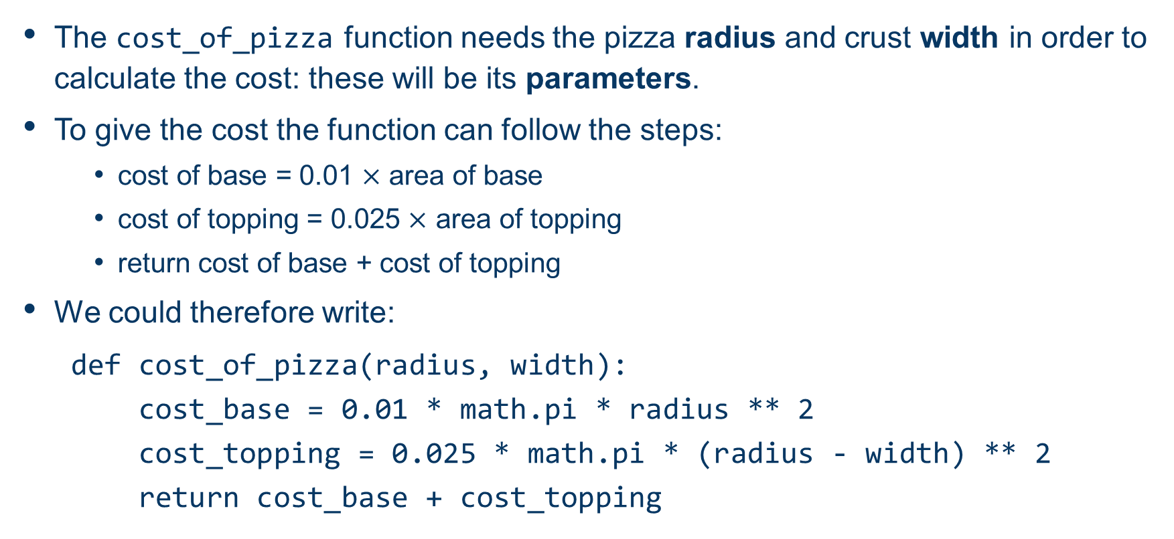
The cost_of_pizza function

Slide 19
The cost_of_pizza function
However, there is repetition here (in the calculation of areas).
A better solution would be to use an extra function that will find areas of circles:
def area(radius):
return math.pi * radius ** 2
def cost_of_pizza(radius, width):
cost_base = 0.01 * area(radius)
cost_topping = 0.025 * area(radius - width)
return cost_base + cost_topping

Slide 20
The main function
The main function is relatively simple to write, and we add a call to main at the bottom to complete our program:
def main():
base = int(input("Pizza radius: "))
crust = int(input("Crust width: "))
cost = cost_of_pizza(base, crust)
print(f"The cost is {cost:.2f} pounds.")
main()

